Slide 1
Response and Operational Updates
Complete County Committee Meeting
June 4, 2020

Slide 2
Welcome and Special Guests
Special Guests
Welcome
Status of the 2020 Census
Census Operational Update
Arlington Self Response Rate
Call to Action!
Strategies for Getting a Complete Count
Takis Karantonis Arlington County Board Member
Matt de Ferranti Arlington County Board Member
Barbara Kanninen Arlington Public Schools Board Member
Beth Lynk Director of the Census Counts campaign at The Leadership Conference on Civil and Human Rights and The Leadership Conference Education Fund
Lisa Chesnel U.S. Census Bureau, Partnership Specialists

Slide 3
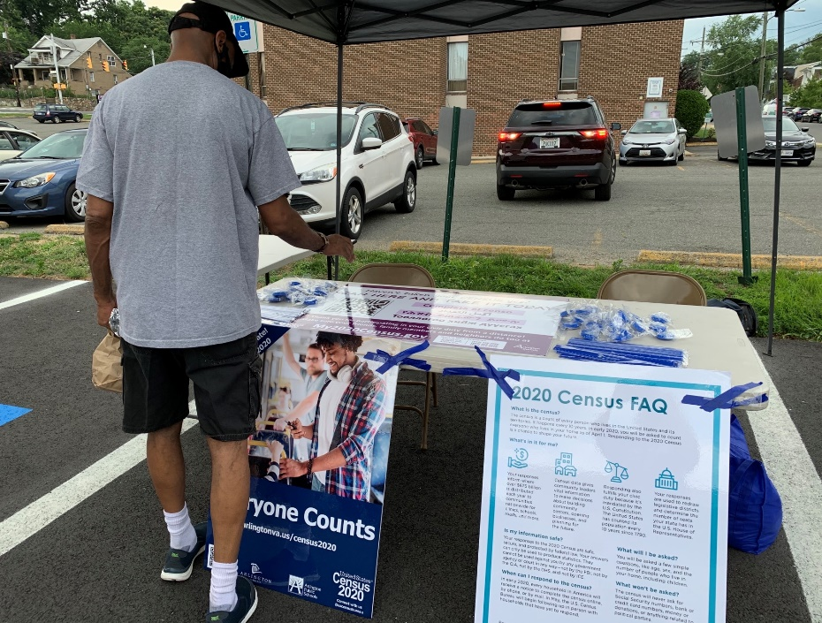
Census Operational Updates: MQA
The Bureau’s Mobile Questionnaire Assistance (MQA) started on July 13. MQA is an initiative where Census response representatives go into communities with the lowest 2020 Census response rates to encourage and assist people with responding on their own to the 2020 Census.
The County and the CCC have been extraordinarily helpful in assisting us with this initiative.
Examples of successful sites:
AFAC
Gates of Ballston
Megamart
Glebe Market

Slide 4
Census Operational Updates: NRFU
Arlington was included in the Crystal City Area Census Office’s soft-launch of Non-response Follow Up (NRFU).Census takers have been out in Arlington since July 23 and the County provided space for training the enumerators.
Please note that even though NRFU is happening, it’s not too late to self-respond! Self-response saves the Bureau time and money.
Some apartment buildings have been resistant to allowing Census takers into their buildings due to COVID-19.The Bureau is working with these apartment buildings to address any issues regarding NRFU.
Field operations and self response will both end on September 30, 2020.

Slide 5
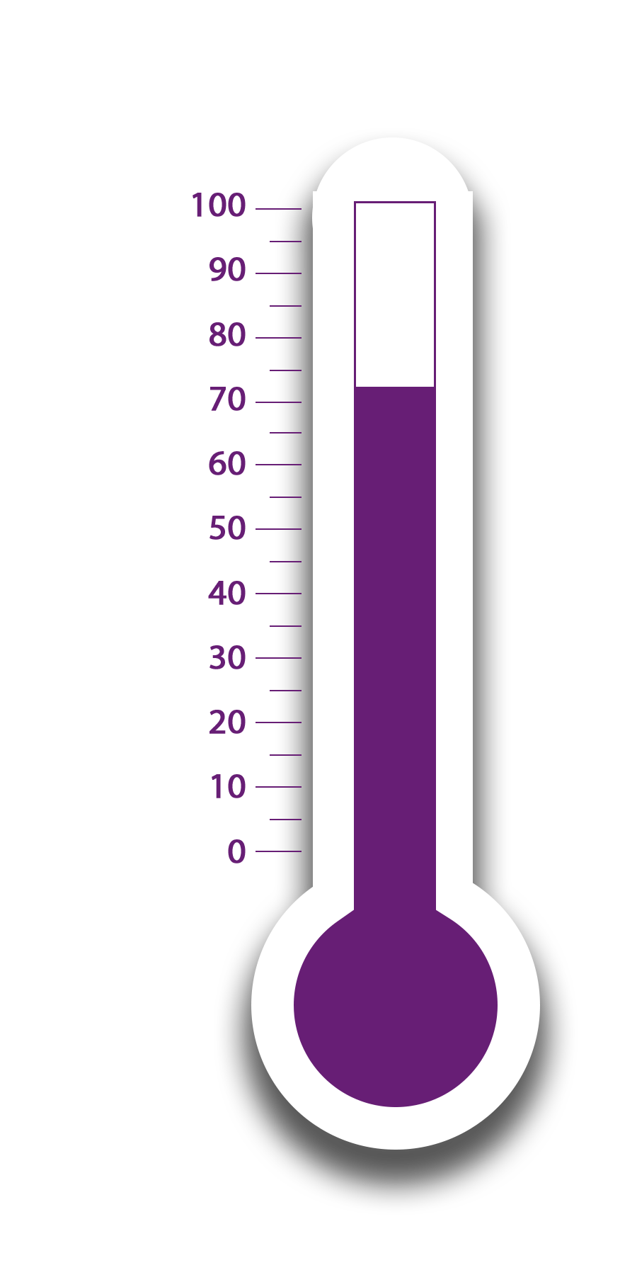
Arlington’s Self-Response Rate (August 10, 2020)
26.6%
~24,900 Households
To go!
73.4%
~85,100 Households
Counted!
Final 2010 Census Self-Response Rate = 73.3%

Slide 6
Regional Response Rate (August 10, 2020)
Jurisdiction | Response Rate
City of Fairfax | 80.6
Falls Church | 80.6
Loudoun County | 79.3
Fairfax County | 77.7
Stafford County | 76.7
Montgomery County | 74.1
Arlington County | 73.4
Fauquier County | 73.1
Prince William County | 72.5
Charles County | 70.9
City of Alexandria | 70.0
Manassas | 68.9
Manassas Park | 68.8
Prince George's County | 65.4
Fredericksburg | 63.2
Washington | 59.7
73.4%
Arlington
68.0%
Virginia
63.3%
United States

Slide 7
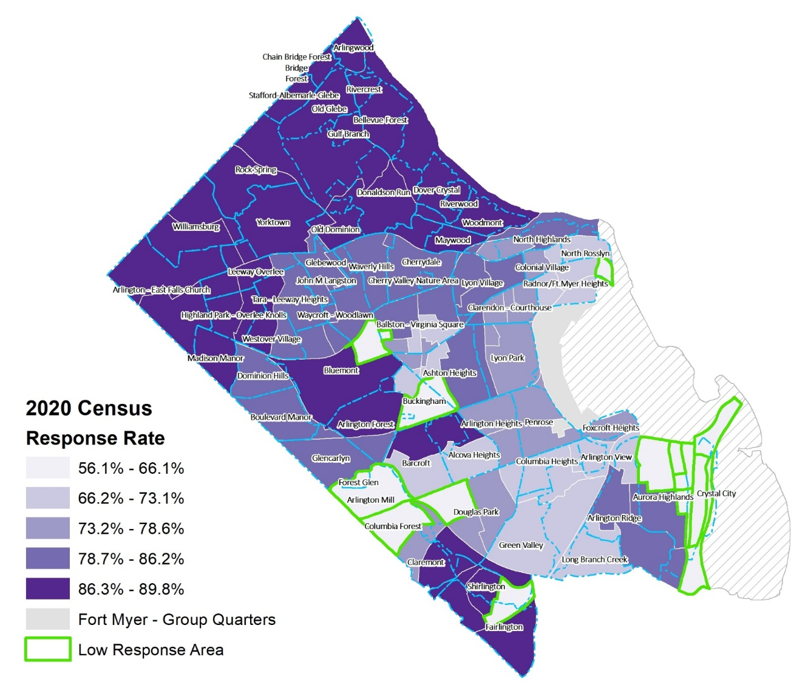
Response Rate by Census Tract (August 10, 2020)
Arlington’s Population residing in the low response areas:, (Tracts with responses less than 66.2% and outlined in green on map)
20.3% of Arlington’s Total Population
40.7% of Arlington’s Black or African American Population
1/3 of Arlington’s Hispanic or Latino Population
27.4% of Arlington’s Asian Population
31.3% of Arlington’s Population living below the poverty level.
42.8% of Arlington’s Population without a high school diploma

Slide 8
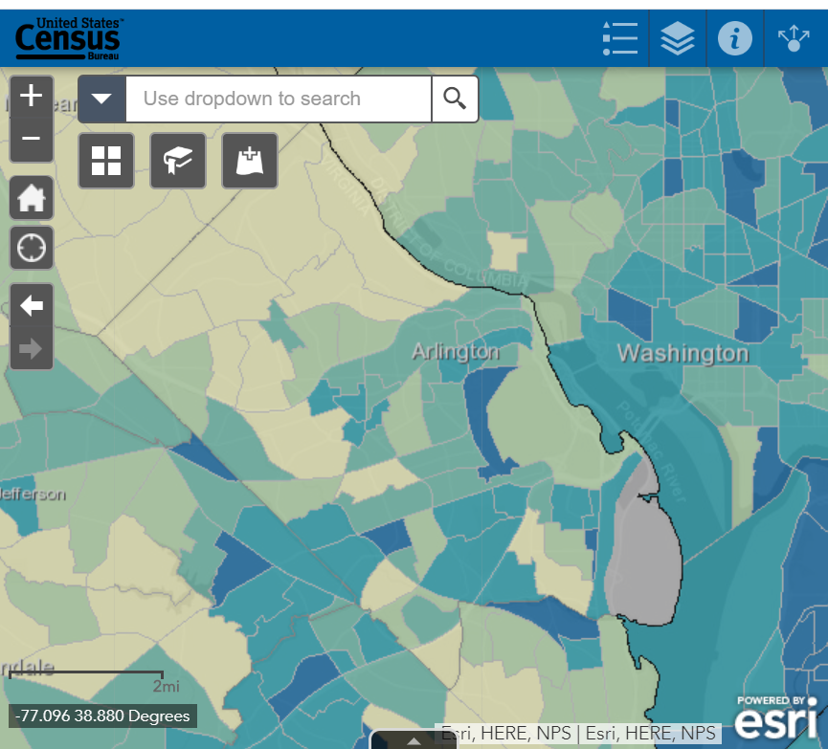
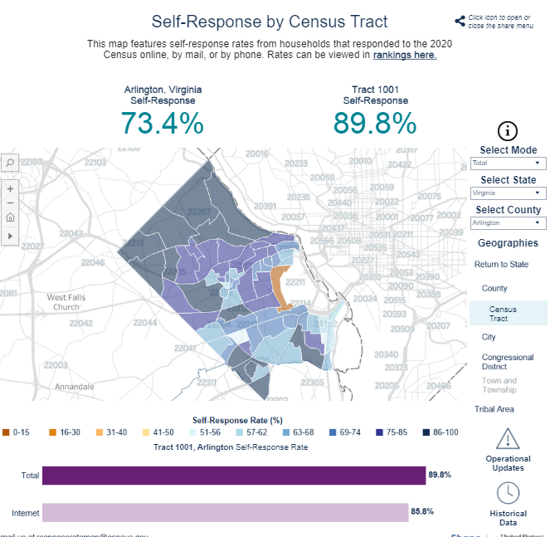
Online Mapping Tools
Response Outreach Area Mapper (ROAM)
https://www.census.gov/roam
Response Rate Map
https://2020census.gov/en/response-rates.html

Slide 9
4-Ways to Take Action!
Everyone Counts!
1
Take the 2020 Census
2
Volunteer at Census Palooza!
3
Call or Email your Friends
4
Share Posts On Social Media

Slide 10
#1 Take the Census
Let others know how easy it is
Encourage them to take it today!
Safe
Important
Confidential
No citizenship question
ONLINE: www.My2020Census.GovMy2020Census.Gov

Slide 11
#2 Volunteer at Census Palooza!
Saturday, August 29
9:30am – 2:00pm
Focused Low Response Areas
Barcroft Apartments
Gates of Ballston Apartments
Green Valley
Activities with safe social distancing
Door hangers
Education
Opportunities to take the Census in real time
https://www.signupgenius.com/go/8050a4eaeaf28a2f58-census1

Slide 12
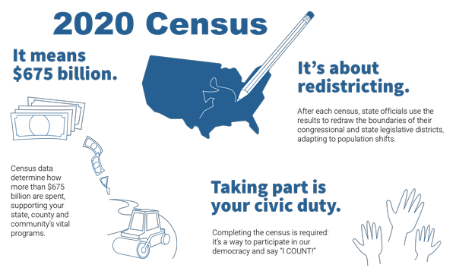
#3 Call or Email a Friend
Tell the people in your network about the Census and why the Census is important…
Receive our fair share of $675 billion dollars in federal funding
Have the appropriate number of representatives in congress
And plan for our community’s future needs.

Slide 13
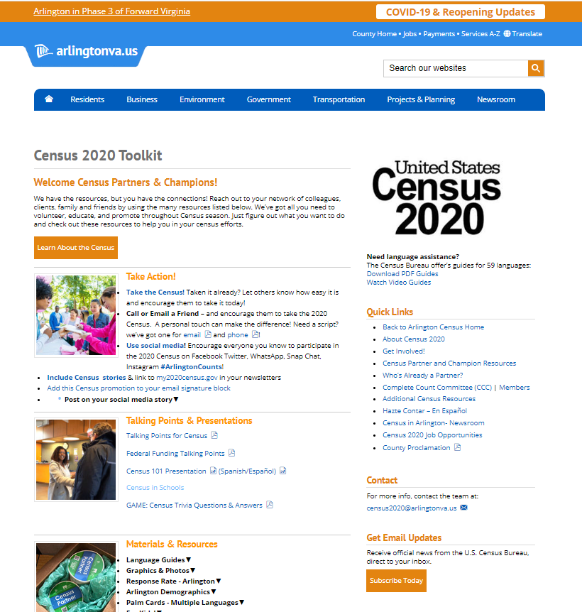
#4 Share Posts on Social Media
Use communications platforms to share
Census newsletters
Arlington Census news stories
Census information in different languages
YOUR OWN STORY!
Arlington County has a Census toolkit full of resources
Arlingtonva.us/Census
Arlingtonva.us/Census>"For Partners & Champions" https://topics.arlingtonva.us/census-2020/census-partner-toolkit/

